Slide 1
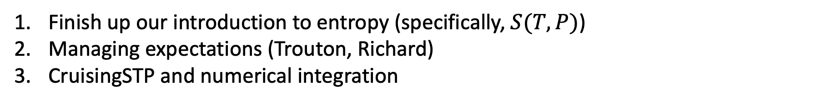
Agenda for today
Finish up our introduction to entropy (specifically, $S(T,P)$)
Managing expectations (Trouton, Richard)
CruisingSTP and numerical integration

Slide 2
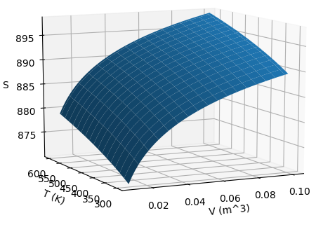
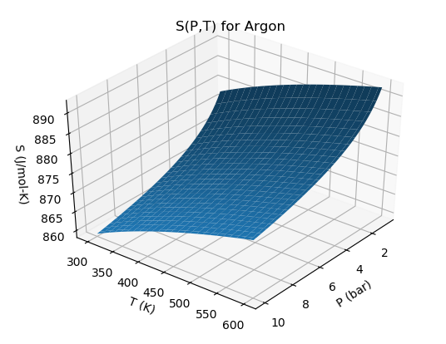


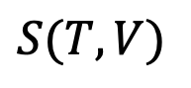
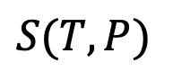
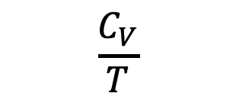


Last time: we introduced the Thermodynamic Definition of Entropy
$$\frac{dq_{rev}}{T}=dS$$
Thermodynamic definition of entropy
$$\frac{C_{P}}{T}$$
$$S(T,V)$$
$$\frac{C_{V}}{T}$$
$$S(T,P)$$
$${\left(\frac{∂S}{∂P}\right)}_{T}$$
$$\frac{α_{P}}{κ_{T}}$$

Slide 3
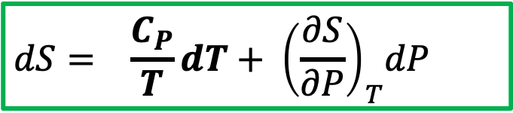
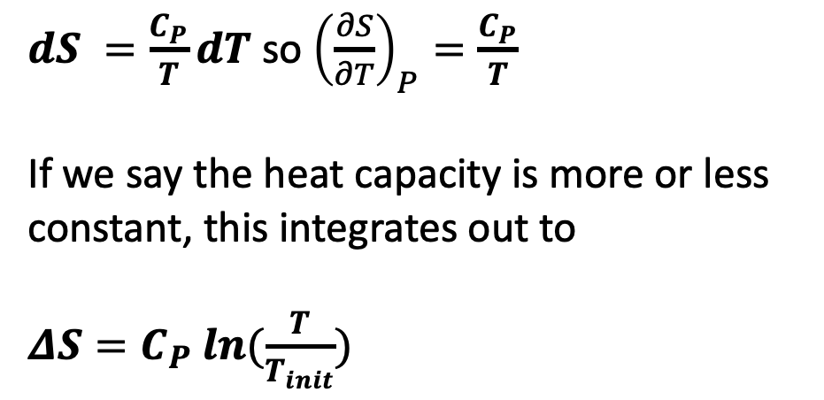


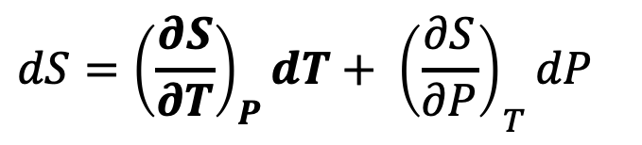
We argued that the slope of $S\left(T,P\right)$ relevant to isobaric heating looks like this
$dS =\frac{C_{P}}{T}dT$ so ${\left(\frac{∂S}{∂T}\right)}_{P}=\frac{C_{P}}{T}$
If we say the heat capacity is more or less constant, this integrates out to
$ΔS=C_{P} ln⁡(\frac{T}{T_{init}})$
$${\left(\frac{∂S}{∂P}\right)}_{T}$$
$${\left(\frac{∂S}{∂T}\right)}_{P}$$
$$dS={{\left(\frac{∂S}{∂T}\right)}_{P}dT+ \left(\frac{∂S}{∂P}\right)}_{T}dP$$
You should probably commit this to memory too
$$dS={ \frac{C_{P}}{T}dT+ \left(\frac{∂S}{∂P}\right)}_{T}dP$$

Slide 4
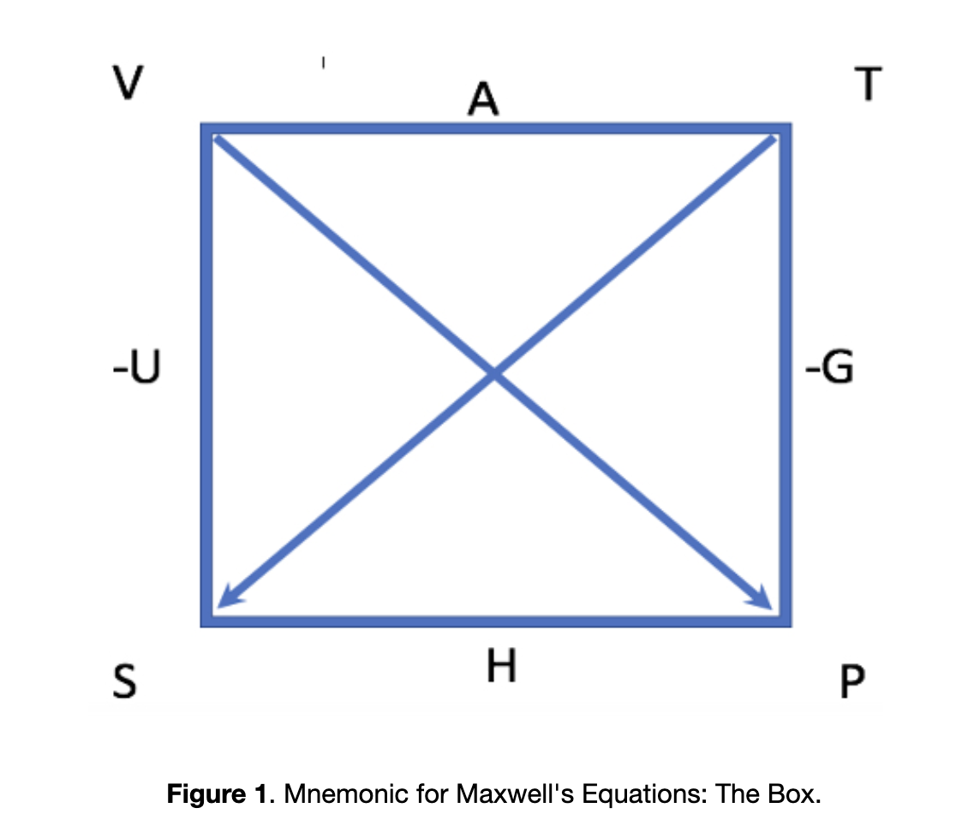
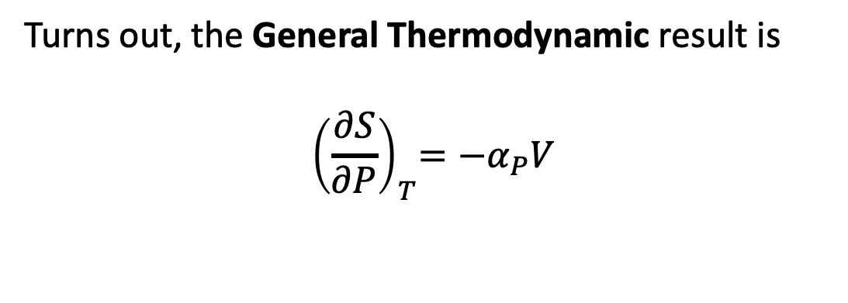
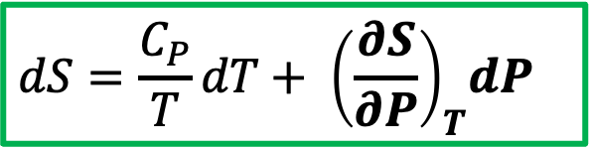
And that the slope of $S\left(T,P\right)$ relevant to isothermal changes in pressure looks like this
Turns out, the General Thermodynamic result is
$${ \left(\frac{∂S}{∂P}\right)}_{T}=−α_{P}V$$
$${\left(\frac{∂S}{∂P}\right)}_{T}$$
$${\left(\frac{∂S}{∂T}\right)}_{P}$$
(Also an arms-around the box Maxwell equation thing ... get to this Friday)
$$dS=\frac{C_{P}}{T}dT+{ \left(\frac{∂S}{∂P}\right)}_{T}dP$$

Slide 5
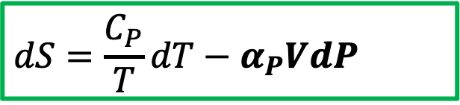
And that the slope of $S\left(T,P\right)$ relevant to isothermal changes in pressure looks like this
Turns out, the General Thermodynamic result is
$${ \left(\frac{∂S}{∂P}\right)}_{T}=−α_{P}V$$
$${\left(\frac{∂S}{∂P}\right)}_{T}$$
$${\left(\frac{∂S}{∂T}\right)}_{P}$$
$$dS=\frac{C_{P}}{T}dT−α_{P}VdP$$
General Thermodynamics

Slide 6
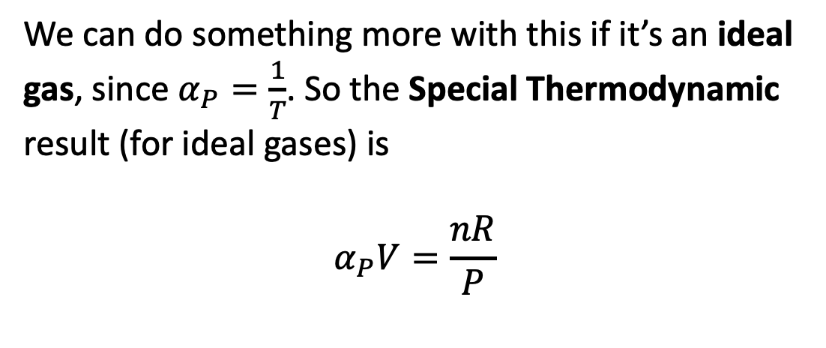
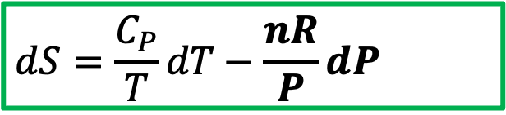
Next: special thermodynamics result for ${\left(\frac{∂S}{∂P}\right)}_{T}$when it’s an ideal gas
We can do something more with this if it’s an ideal gas, since $α_{P}=\frac{1}{T}$. So the Special Thermodynamic result (for ideal gases) is
$$α_{P}V=\frac{nR}{P}$$
$${\left(\frac{∂S}{∂P}\right)}_{T}$$
$${\left(\frac{∂S}{∂T}\right)}_{P}$$
$$dS=\frac{C_{P}}{T}dT−\frac{nR}{P}dP$$
Special Thermodynamics (ideal gas)

Slide 7
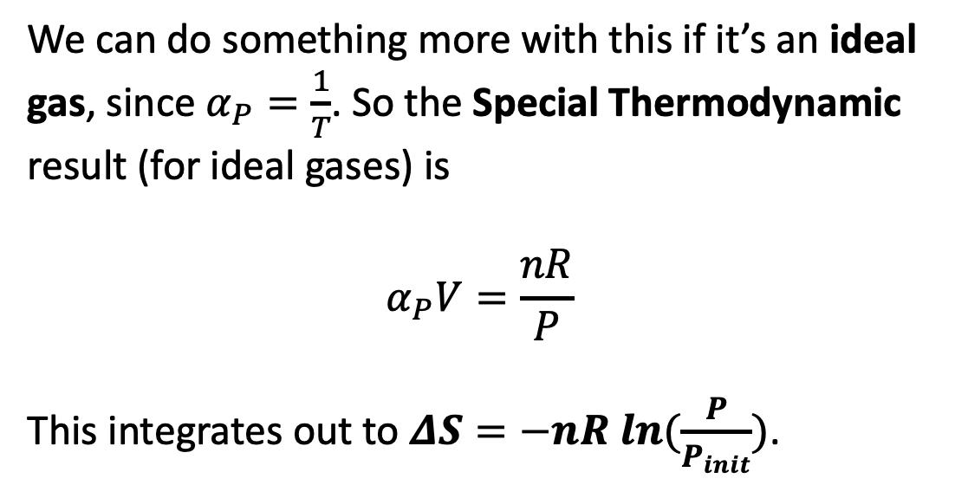
Next: special thermodynamics result for ${\left(\frac{∂S}{∂P}\right)}_{T}$when it’s an ideal gas
We can do something more with this if it’s an ideal gas, since $α_{P}=\frac{1}{T}$. So the Special Thermodynamic result (for ideal gases) is
$$α_{P}V=\frac{nR}{P}$$
This integrates out to $ΔS=−nR ln⁡(\frac{P}{P_{init}})$.
$${\left(\frac{∂S}{∂P}\right)}_{T}$$
$${\left(\frac{∂S}{∂T}\right)}_{P}$$
You should probably commit this to memory too
$$dS=\frac{C_{P}}{T}dT−\frac{nR}{P}dP$$
Special Thermodynamics (ideal gas)

Slide 8

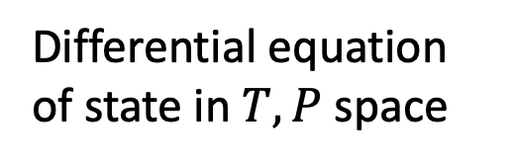
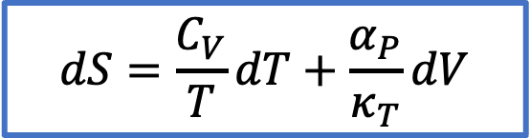
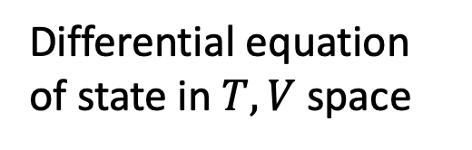

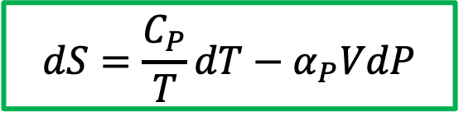
Summary: General Thermodynamics results for $S\left(T,V\right)$ and $S\left(T,P\right)$
$$S(T,V)$$
$$\frac{C_{V}}{T}$$
$$dS=\frac{C_{V}}{T}dT+\frac{α_{P}}{κ_{T}}dV$$
Differential equation of state in $T,V$ space
$$\frac{α_{P}}{κ_{T}}$$
$$\frac{dq_{rev}}{T}=dS$$
Thermodynamic definition of entropy
$$\frac{C_{P}}{T}$$
$$S(T,P)$$
$$dS=\frac{C_{P}}{T}dT−α_{P}VdP$$
Differential equation of state in $T,P$ space
$$−α_{P}V$$

Slide 9
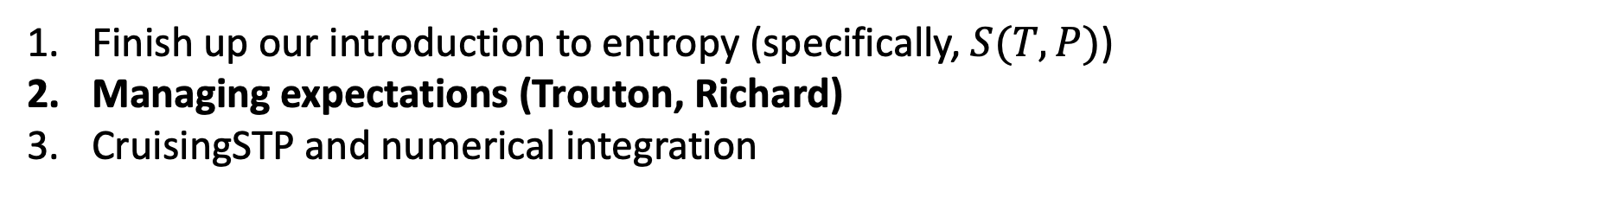
Agenda for today
Finish up our introduction to entropy (specifically, $S(T,P)$)
Managing expectations (Trouton, Richard)
CruisingSTP and numerical integration

Slide 10
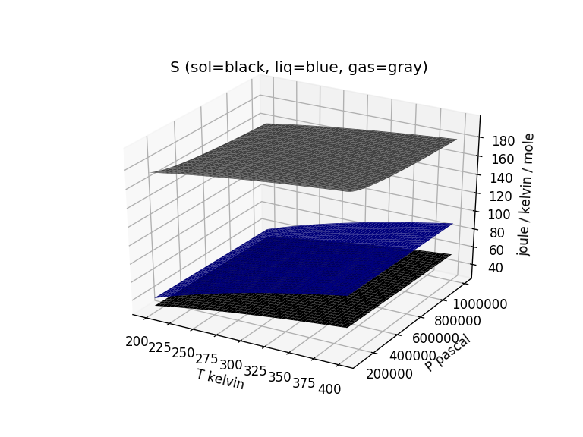
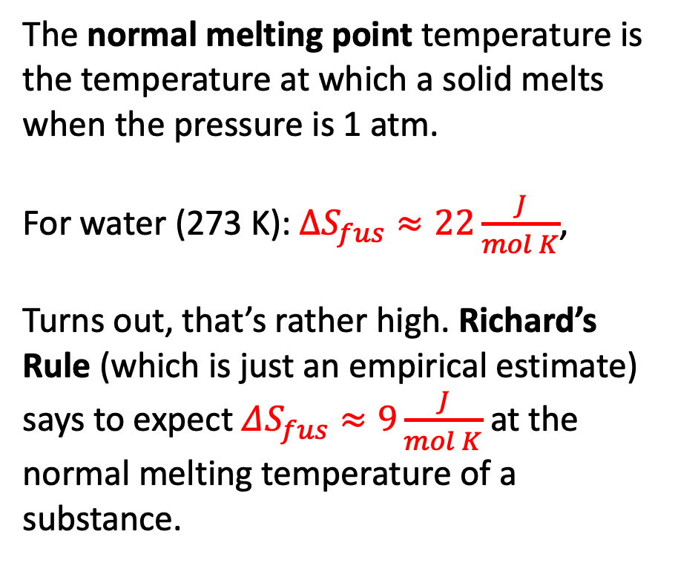
Entropy of fusion: Richard’s Rule
The normal melting point temperature is the temperature at which a solid melts when the pressure is 1 atm.
For water (273 K): $∆S_{fus}≈22\frac{J}{mol K}$,
Turns out, that’s rather high. Richard’s Rule (which is just an empirical estimate) says to expect $ΔS_{fus}≈9\frac{J}{mol K}$ at the normal melting temperature of a substance.

Slide 11
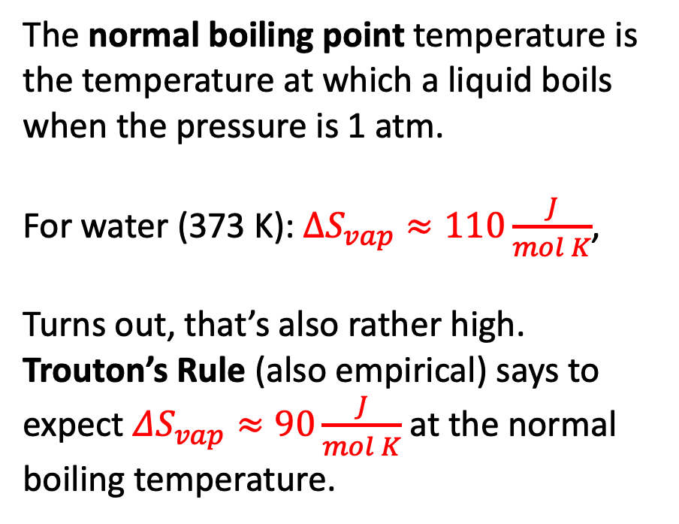
Entropy of vaporization: Trouton’s Rule
The normal boiling point temperature is the temperature at which a liquid boils when the pressure is 1 atm.
For water (373 K): $∆S_{vap}≈110\frac{J}{mol K}$,
Turns out, that’s also rather high. Trouton’s Rule (also empirical) says to expect $ΔS_{vap}≈90\frac{J}{mol K}$ at the normal boiling temperature.

Slide 12
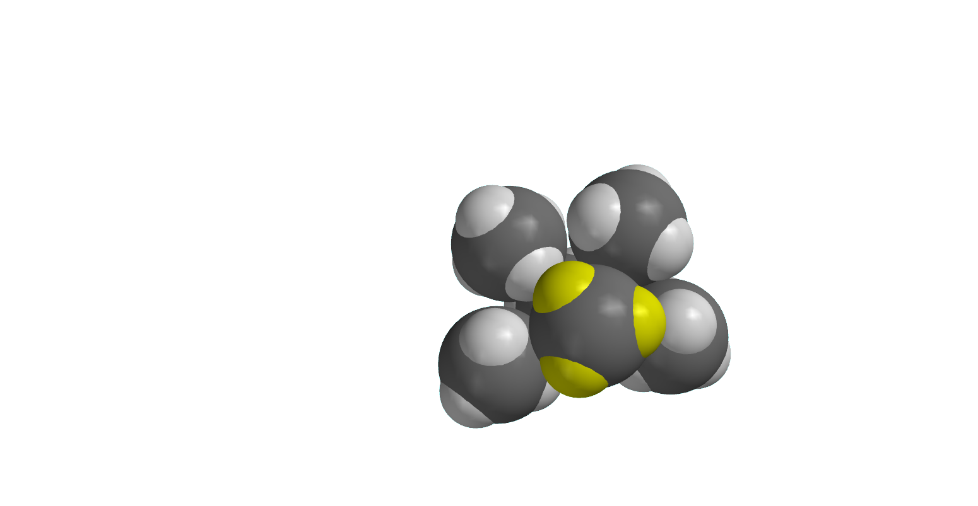
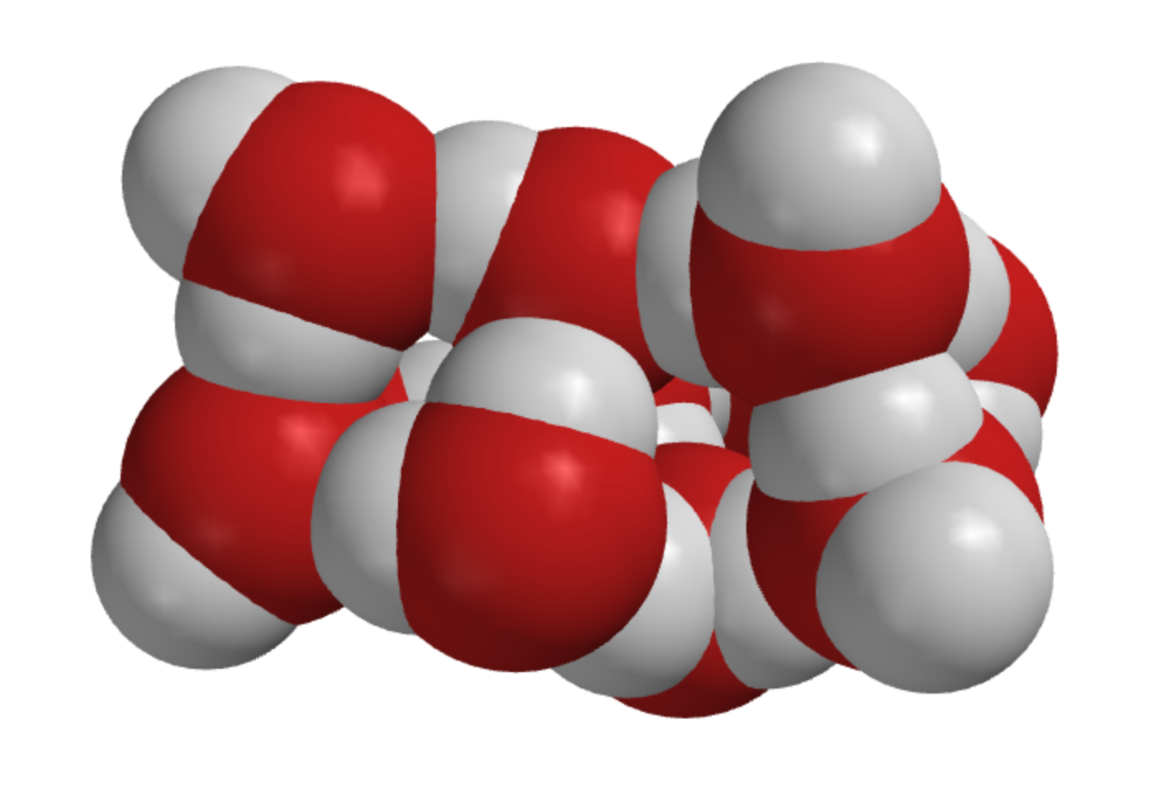
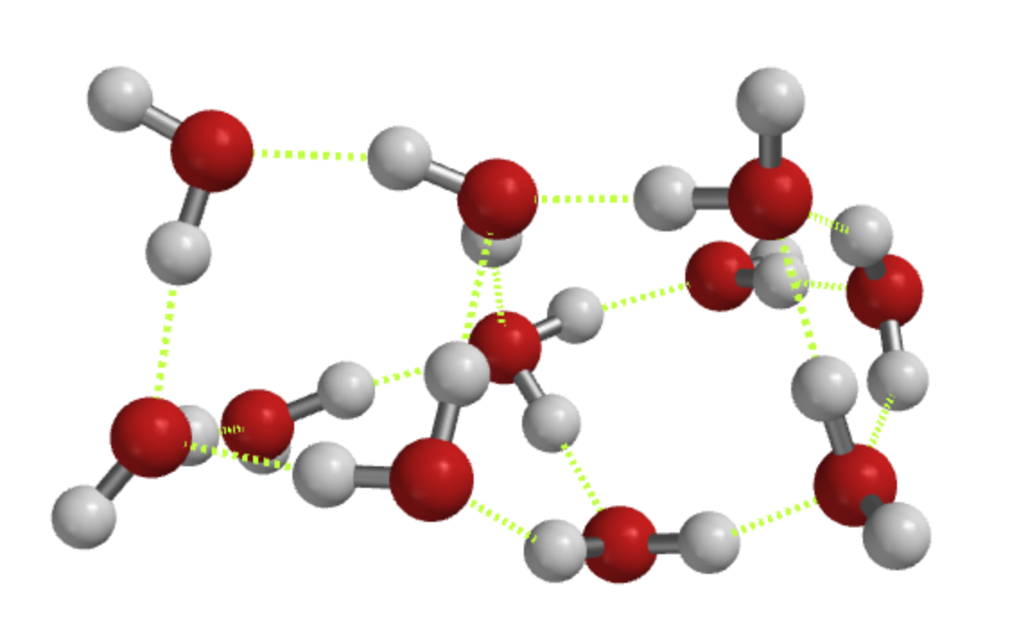
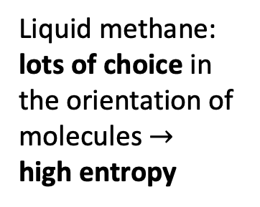
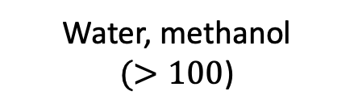
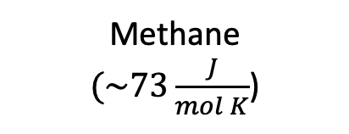
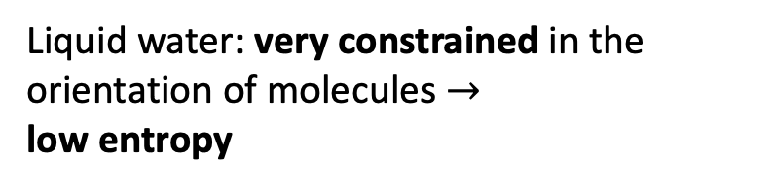
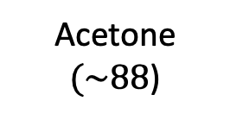
Why $∆S_{vap}$ of water is so big
Methane
$(\sim 73\frac{J}{mol K}$)
Acetone
$(\sim 88$)
Water, methanol
$(>100$)
Liquid water: very constrained in the orientation of molecules $→$
low entropy
Liquid methane: lots of choice in the orientation of molecules $→$
high entropy
Notes:
https://slideplayer.com/slide/7362502/

Slide 13
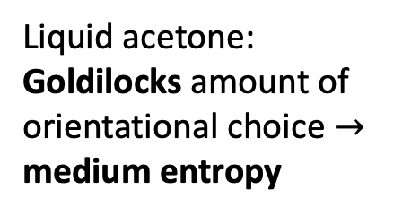
Why $∆S_{vap}$ of water is so big
Methane
$(\sim 73\frac{J}{mol K}$)
Acetone
$(\sim 88$)
Water, methanol
$(>100$)
Liquid water: very constrained in the orientation of molecules $→$
low entropy
Liquid methane: lots of choice in the orientation of molecules $→$
high entropy
Liquid acetone: Goldilocks amount of orientational choice $→$
medium entropy
Notes:
https://slideplayer.com/slide/7362502/

Slide 14
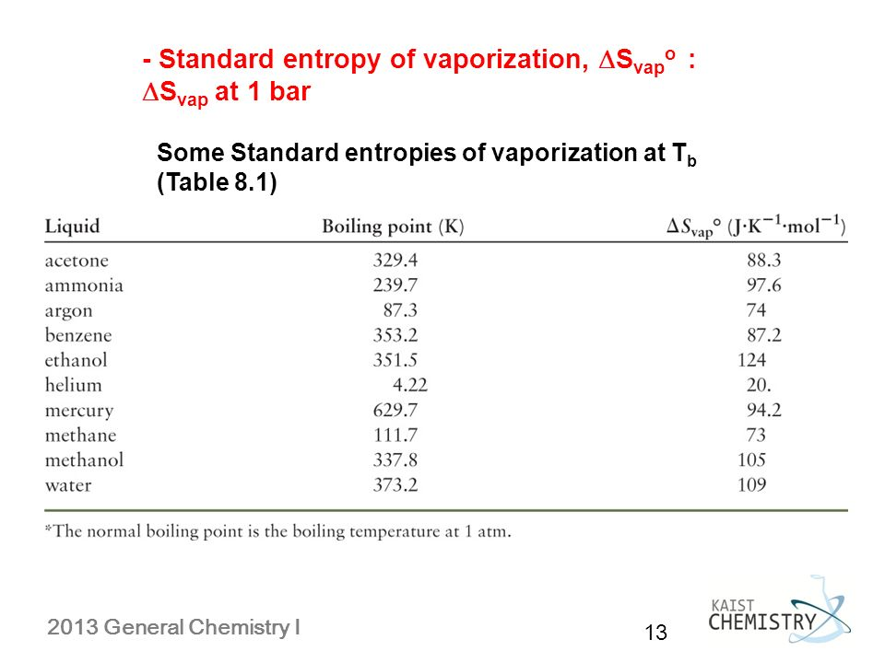
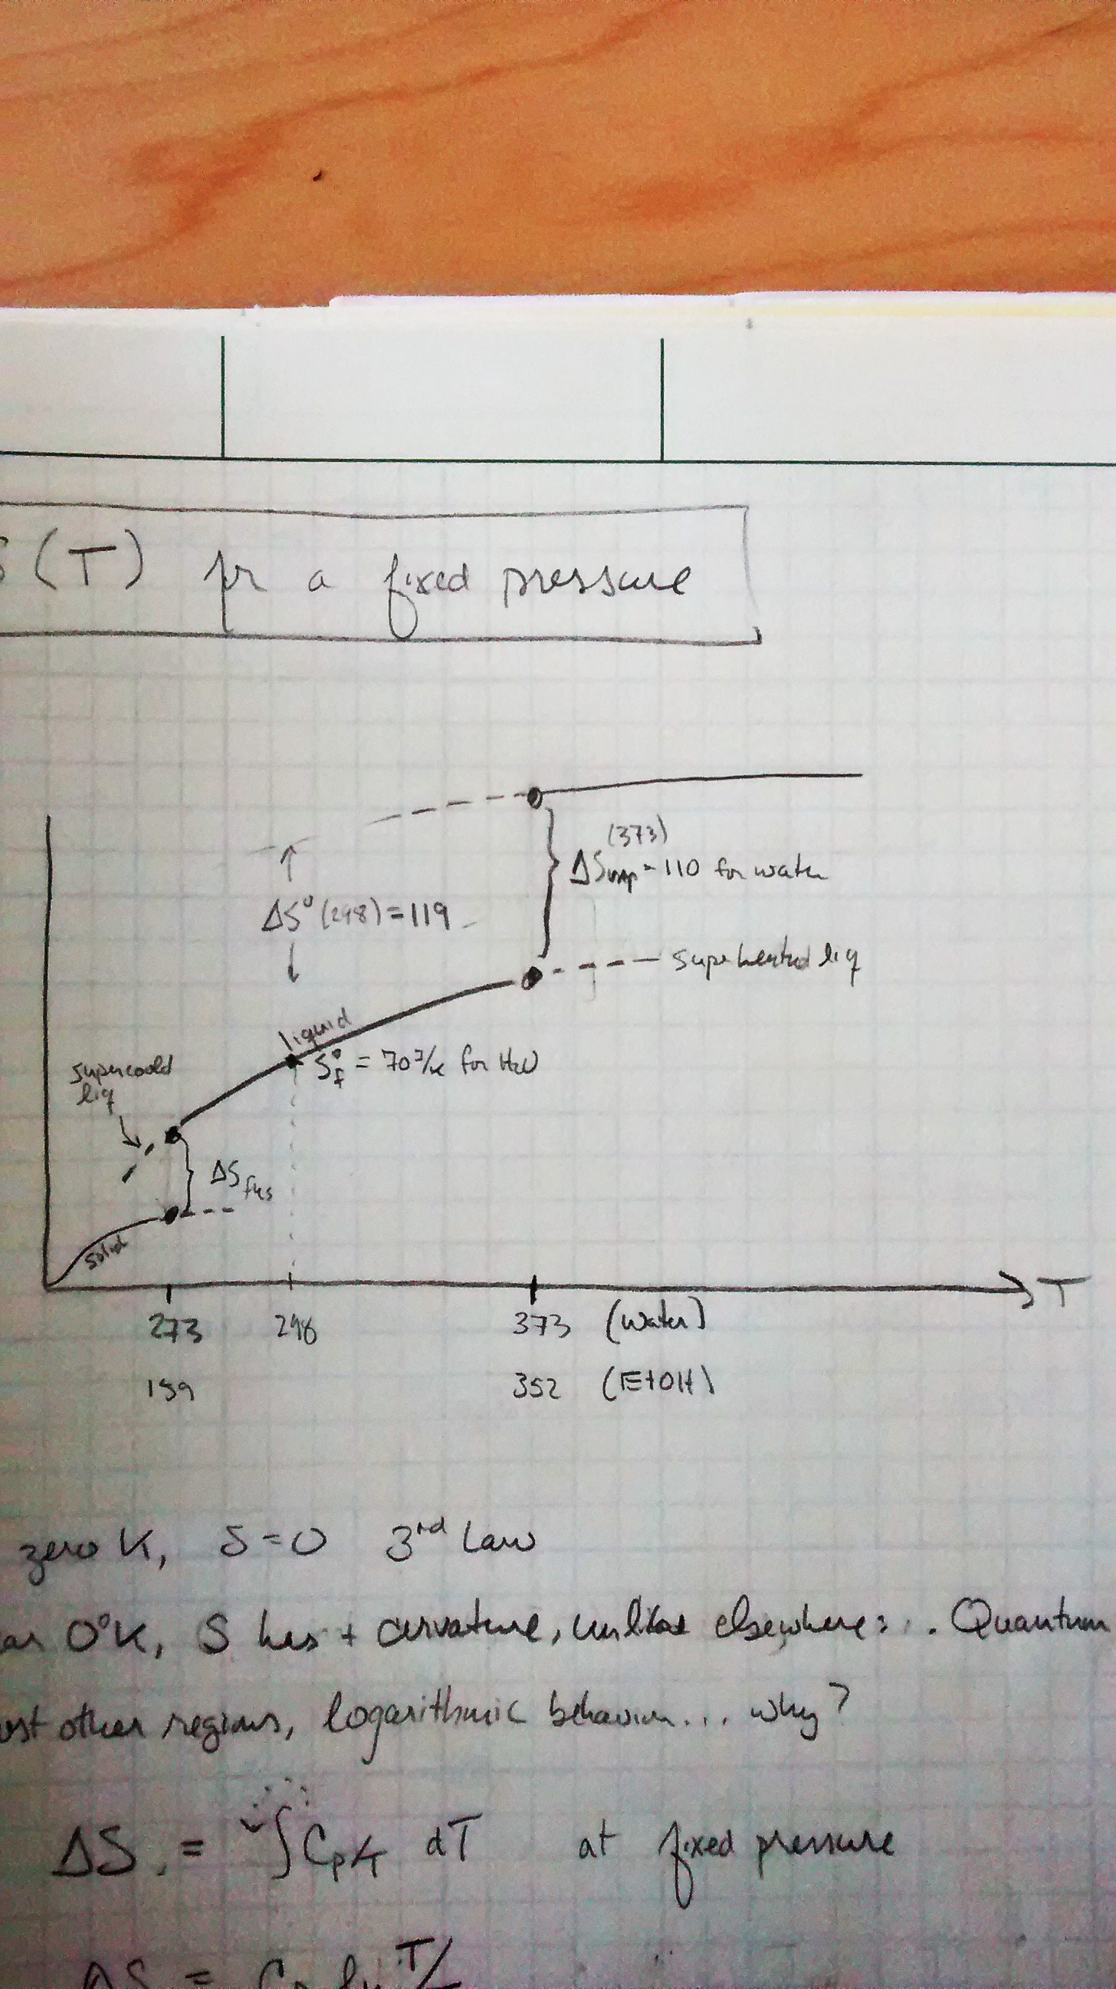
Summarizing some of these ideas
S
Standard state entropies of formation (from a table)
What Richard’s rule approximates (and some tables tell you precisely)
What Trouton’s rule approximates (and some tables tell you precisely)

Slide 15
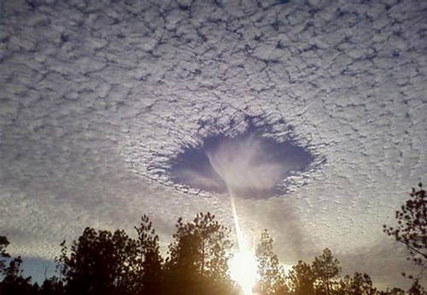
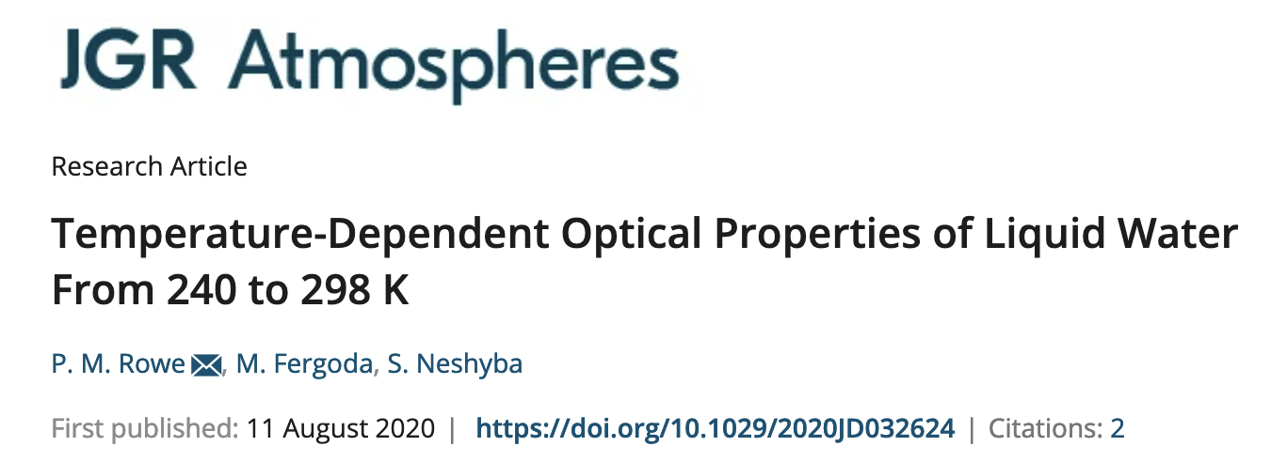
Supercooling and superheating
https://forum.xcitefun.net/punch-hole-clouds-layer-of-supercooled-clouds-t16564.html
S

Slide 16
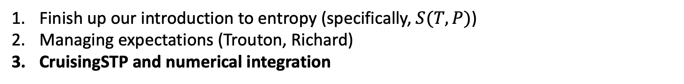
Agenda for today
Finish up our introduction to entropy (specifically, $S(T,P)$)
Managing expectations (Trouton, Richard)
CruisingSTP and numerical integration

Slide 17
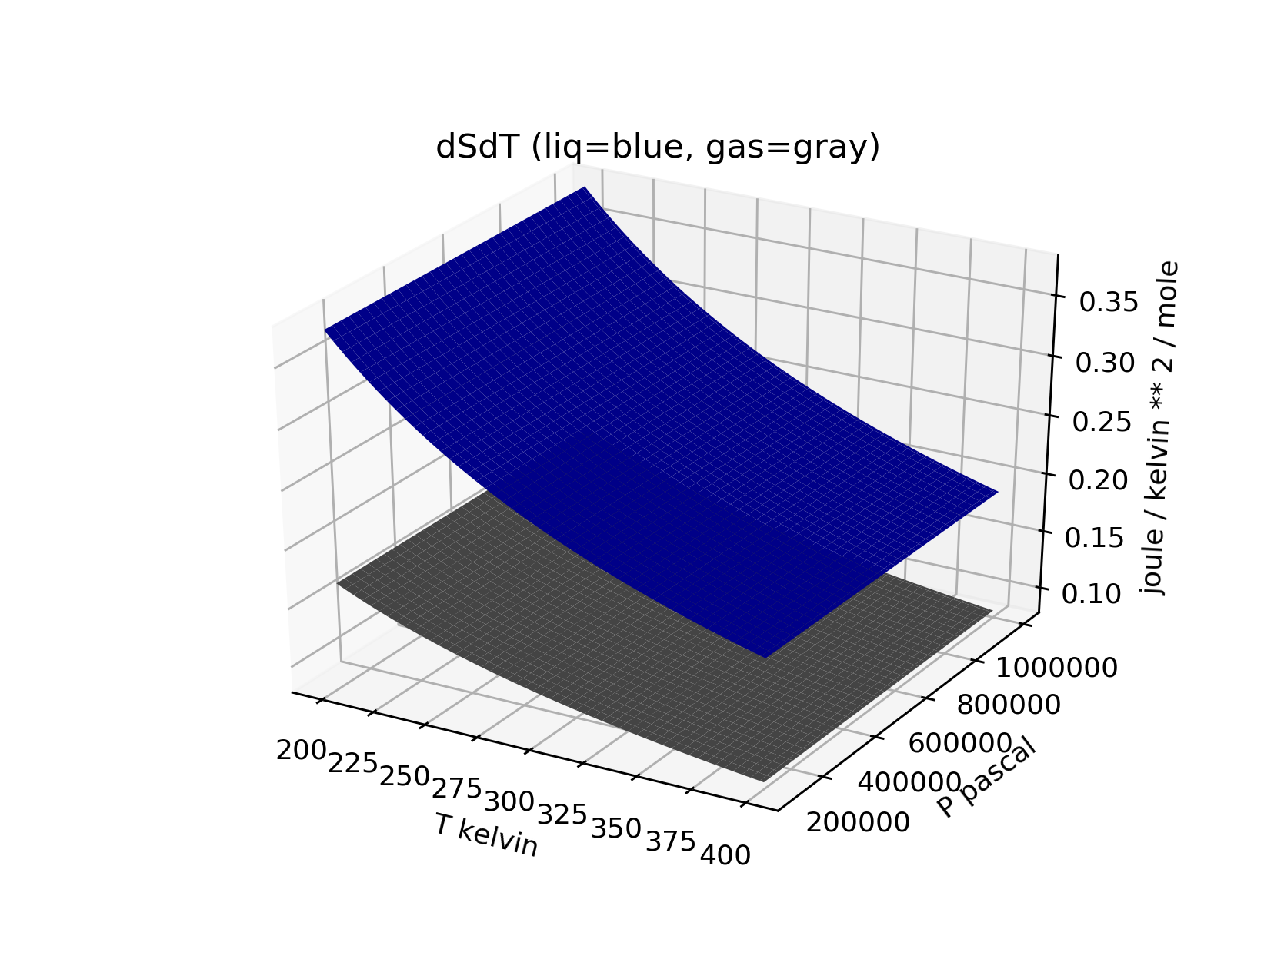
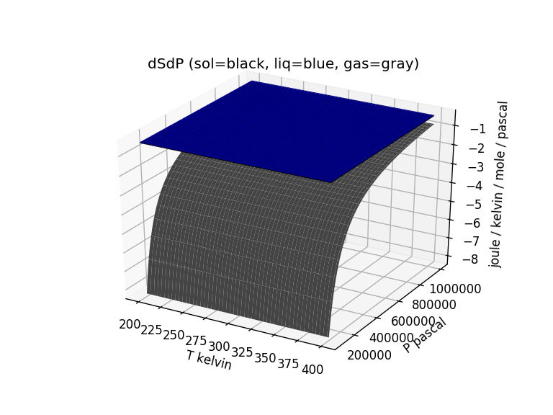
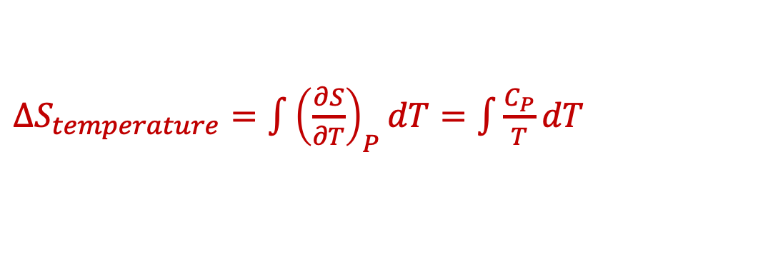
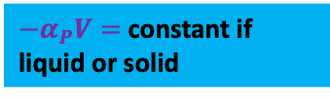
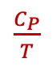
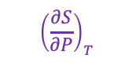
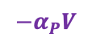
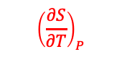
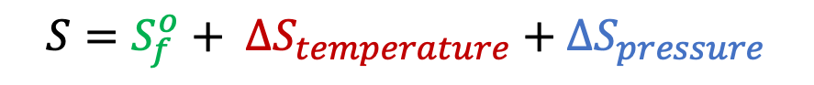
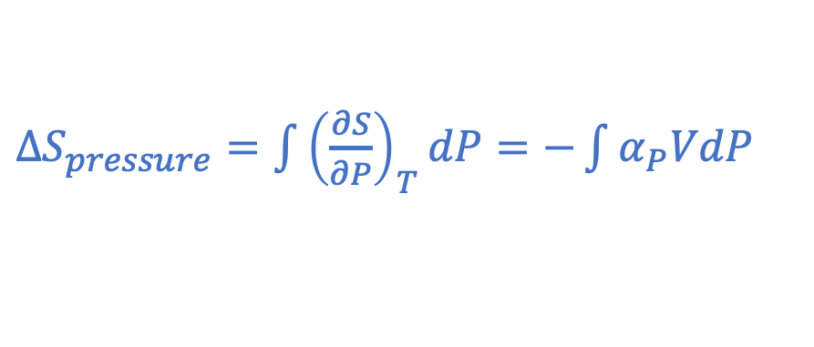
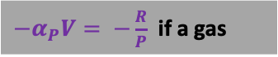
The CGI on this focuses on $S(T,P)$ and $∆S_{trs}(T,P)$
${−α}_{P}V=$constant if liquid or solid
$\frac{C_{P}}{T}$
${−α}_{P}V= −\frac{R}{P}$ if a gas
$${−α}_{P}V$$
$∆S_{temperature}=\int{{\left(\frac{∂S}{∂T}\right)}_{P}dT}=\int{\frac{C_{P}}{T}dT}$
$∆S_{pressure}=\int{{\left(\frac{∂S}{∂P}\right)}_{T}dP}=−\int{α_{P}VdP}$
$${\left(\frac{∂S}{∂P}\right)}_{T}$$
$${\left(\frac{∂S}{∂T}\right)}_{P}$$
$$S=S_{f}^{o}+ ∆S_{temperature}+∆S_{pressure}$$

